Slide 1
On Plane Spanning Trees and Cycles of Multicolored Point Sets with Few Intersections
Information Processing Letters 93(2005) 301-306
M. Kano, C. Merinob, J. Urrutiab
Presenter: Jun-Shong Lin
Date: July 13, 2006

Slide 2
Abstract
Let P₁, . . . , P_{k} be a collection of disjoint point sets in R² in general position. We prove that for each 1 ≤ i ≤ k we can find a plane spanning tree T_{i} of P_{i} such that the edges of T₁, . . .,T_{k} intersect at most (k − 1)(n − k) + ½k(k − 1), where n is the number of points in P₁ ∪ ··· ∪ P_{k}. If the intersection of the convex hulls of P₁, . . .,P_{k} is nonempty, we can find k spanning cycles such that their edges intersect at most (k−1)n times, this bound is tight.

Slide 3
Abstract
We also prove that if P and Q are disjoint point sets in general position, then the minimum weight spanning trees of P and Q intersect at most 8n times, where |P ∪ Q| = n
(the weight of an edge is its length).

Slide 4
Introduction

Slide 5
Introduction
Theorem 1. Let P₁, . . . ,P_{k} be a collection of disjoint point sets. Then we can find for each P_{i} a spanning tree T_{i} such that the total number of intersections among the edges of T₁, . . . ,T_{k} is at most (k − 1)(n− k)+ ½ k(k − 1) where |P₁∪···∪P_{k}| = n. This bound is tight within a factor of two from the optimal solution.
P₁
P₃
n = 12 ,k = 3.
P₂

Slide 6
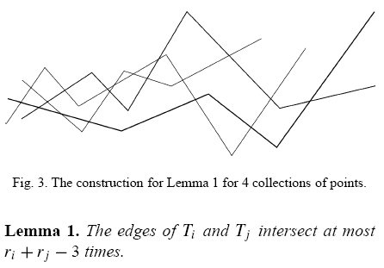
Spanning Trees with Few
Intersections
Without loss of generality that the points in P₁ ∪ ··· ∪ P_{k} have different x-coordinates, and |P_{i} | 2, i = 1, . . .,k.
By induction:
T_{i}
T_{j}
X

Slide 7
Spanning Trees with Few
Intersections
Lemma 2. The edges of T₁, . . . ,T_{k} intersect at most
(k − 1)(n − k) + ½k(k − 1) times, where |P₁ ∪ ··· ∪P_{k}| = n.
<1>.At most k edges:
At most Intersection: ½k(k − 1)
<2>.More than k edges:
By induction:
T_{i}
T₁
T_{j}
At most k-1 intersections!
T_{k}

Slide 8
Spanning Cycles
Let P₁, . . . ,P_{k} be a family of disjoint point sets such that Conv(P₁)∩ ··· ∩ Conv(P_{k}) ≠ ∅. Find a family of spanning cycles C₁, . . . ,C_{k} of P₁, . . . ,P_{k} , respectively, with few intersections.

Slide 9
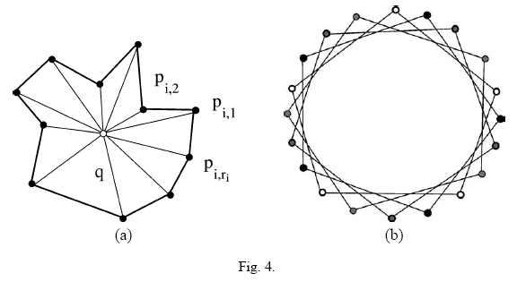
Spanning Cycles
Theorem 2. Let P₁, . . . ,P_{k} be disjoint point sets such that Conv(P₁)∩···∩Conv(P_{k}) ≠∅. Then for each P_{i} we can find a cycle C_{k} which covers the vertices of P_{i} such that the edges of all cycles C_{i}, . . . ,C_{k} intersect at most (k − 1)n times. Our bound is optimal.
C₁
C₂
C₃
C₄

Slide 10
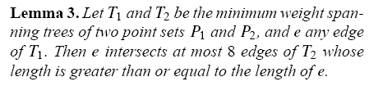
Minimum Weight Spanning Trees
P₁, . . . ,P_{k} are disjoint point sets and T₁, . . . ,T_{k} are their corresponding euclidean minimum weight spanning trees then the total number of intersections among their edges is at most 8(k − 1)(n − k) where
|P₁ ∪···∪ P_{k}| = n.

Slide 11
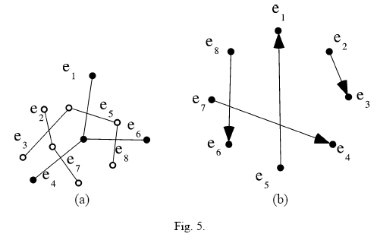
Minimum Weight Spanning Trees
Theorem 3. Let T₁, . . . ,T_{k} be respectively the minimum weight spanning trees of k point sets P₁, . . . ,P_{k} such that |P₁ ∪ ··· ∪ P_{k}| = n. Then the edges of T₁, . . . ,T_{k} intersect at most 8(k − 1)(n− k) times.
At most 8(k-1) intersections!

